Slide 1
Magas szintű programozási nyelvek 2
By Tarcsa Tamás
2021

Slide 2

Agenda
01
Generics again
02
Exception handling
03
IO in Java
04
Exercises

Slide 3
Generics again

Slide 4
Concept of generic types
Generic types: A generic class or interface that is parameterized over types.
The type parameter section, delimited by angle brackets (<>), follows the class name. It specifies the type parameters (also called type variables). T1, T2, …. , Tn.
Type parameter names must be a single uppercase letter.
You can think of a generic invocation as being similar to an ordinary method invocation, but instead of passing an argument to a method, you are passing a type argument.
In Java SE 7 and later you can replace the type arguments required to invoke the constructor of a generic class with an empty set of type arguments as long as the compiler can determinate or infer the type from the context.
(

Slide 5
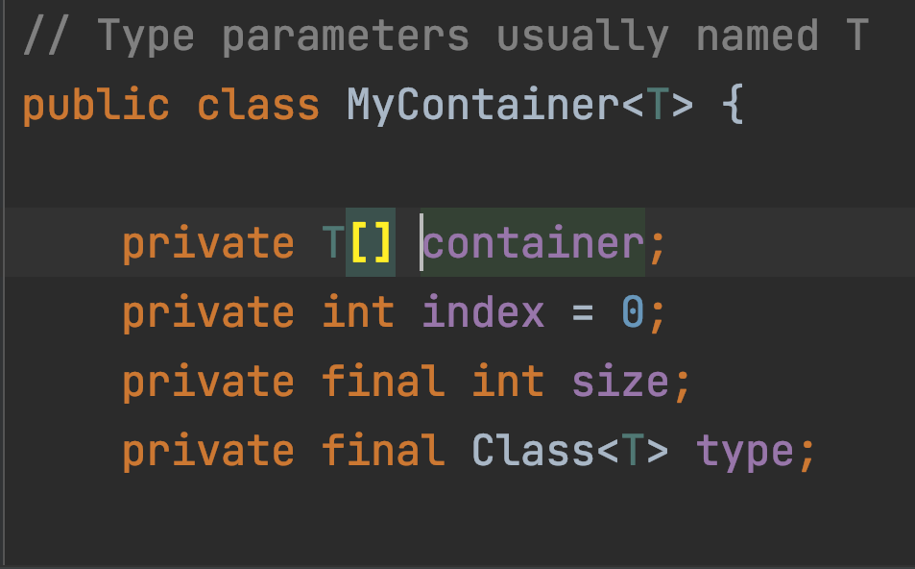
Examples
(
Diamond operator

Slide 6
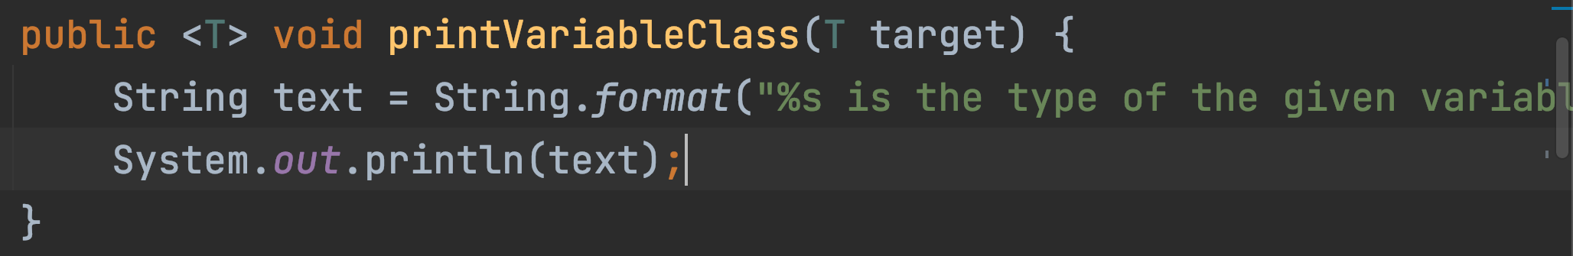
Concept of generic methods
Generic methods: Generic methods are method that introduce their own type parameter that is limited to the methods scope. Static and non-static generic methods are allowed.
The syntax for a generic method includes a list of type parameters inside angle brackets which appears before the method’s return type.
(

Slide 7
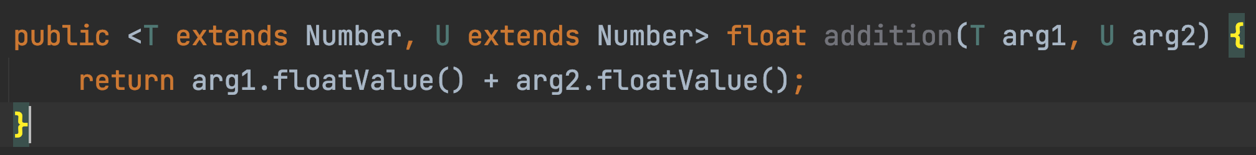
Bounded type parameters
There may be times when you want to restrict the types that can be used as type arguments in a parameterized type. For example: A method that only operates on numbers. This is what bounded type parameters are for.
To declare a bounded type parameter, list the type parameter’s name. followed by the extends keyword what is followed by the upper bound.
Bounded type parameters allow you to invoke methods defined in the bounds. A type can have multiple bounds(&).
(

Slide 8
Wildcards
In a generic code, the question mark(?), called the wildcard, represents an unknown type. Never used as an argument for generic methods, classes or interfaces.
Upper bound wildcard:
List<? extends Number> means: Type must be number or any of its subclasses.
Unbounded wildcard: List<?> means: List of unknown type. When this is useful?
When writing a method that only uses Object methods
When the code does not depends on the type. (for example: List.clear())
(

Slide 9
Wildcards
Lower bound wildcards: Expressed using the ‘?’ following by the super keyword, followed by its lower bound.
List<? super Integer> means: Integer and all of its superclasses are accepted.
Wildcard guidelines:
An “in” variable is defined with an upper bound wildcard.
An “out” variable is defined with a lower bound wildcard.
In case you only need methods from object, use unbounded wildcard
In case the code needs to access specific types, do not use wildcard.
(

Slide 10
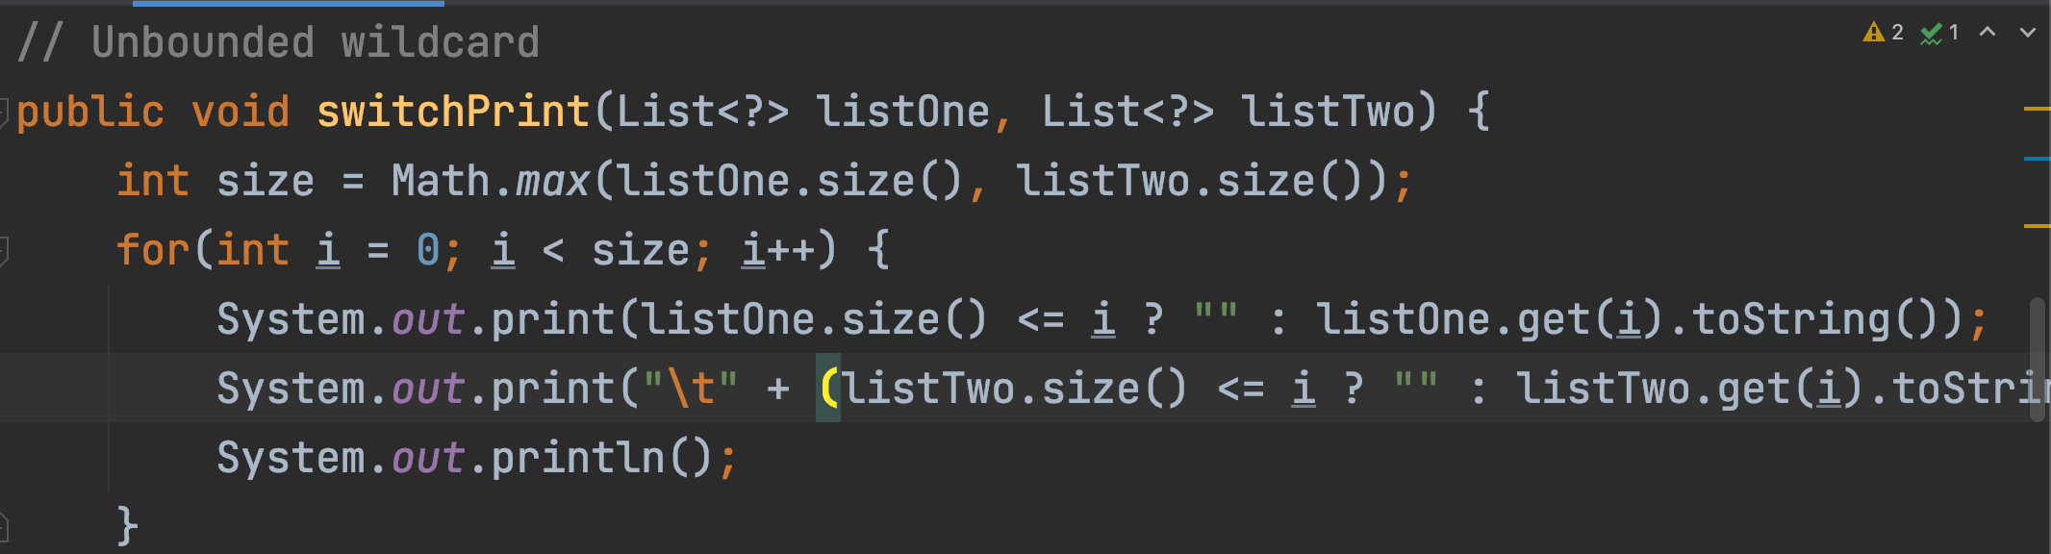
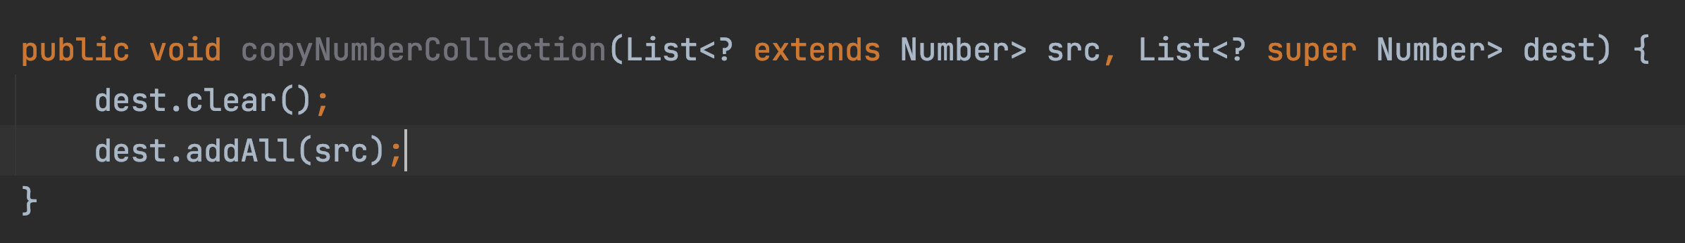
Examples
(

Slide 11
Exception handling

Slide 12
Concepts
In Java (just like in every other language) the code can experience errors while executing our instruction. Good exception handling can handle errors and gracefully re-route the program to give the user still a positive experience.
Why use exception handling? When everything works as expected (network, files, JVM) that’s called happy path.
But usually, our path is the unhappy path.
Without exception handling an otherwise healthy program may stop running altogether!

Slide 13
Exception hierarchy
Throwable
(checked)
Exception
(checked)
Error
(unchecked)
RuntimeException
(unchecked)

Slide 14
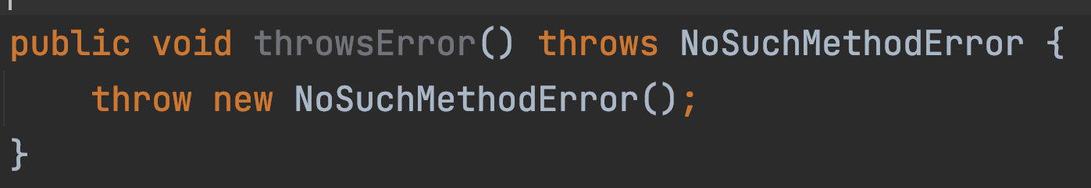
Checked exceptions
Checked exceptions are exceptions that the Java compiler requires us to handle. We have to declaratively throw it up the call stack or we have to handle it ourselves.
When to use it? When a client can reasonably be expected to recover from an exception, make it a checked exception. If a client cannot do anything to recover from the exception, make it an unchecked exception.

Slide 15
Unchecked exceptions
Unchecked or Runtime exceptions are exceptions that the Java compiler does not require us to handle. If we create an exception that extends RuntimeException it will be unchecked, otherwise it will be checked.
Errors
Errors represent serious and usually irrecoverable conditions like memory leak, infinite recursion or library incompatibility. Even though they don’t extend RuntimeException, they are also unchecked. In most cases it’d be weird for us to handle, instantiate or exrend Errors.

Slide 16
Handling exceptions
The simplest way to handle an exception is to rethrow it. But It means that anyone that calls our method need to handle it too.
Try-catch:
Try: covers the critical statements
Catch: are specific to exception types (rethrowing is possible)
Finally: Always executed (?)
From Java 8 we can use try-with-resources. It works with everything that extends AutoClosable

Slide 17
Handling exceptions
You can have multiple catch blocks each handles a certain exception. But be careful because they will be checked in the order of definition.
You can have union catch blocks which means, you can handle multiple exceptions in a single block. Use ‘|’ to define a union catch block.
You can throw exception by using the ’throw’ keyword.
For example: throw new IllegalArgumentException(“message”)
You can wrap exceptions into each other.
For example: throw new MyException(anotherException)

Slide 18
Do not!!!
Swallow exceptions: It means you don’t handle the exception. (empty catch block)
Use return in a finally block: because if you do you can unintentionally swallow exceptions.
Use throw in a finally block: same as the one before.

Slide 19
Exercises
Write a method that takes a String as a parameter that looks like the following: “1,2,3,4,5,6,7”. The method should calculate the sum of the numbers. Handle the unhappy paths too.
Write your generic array implementation.
Use the learned exception handling methods to handle the occurring exceptions (array is full, array is empty and trying to get element, etc.) (Create at least one custom exception)
Write a java method that compute the sum of the digits in an integer.

Slide 20
See you next week

